Slide 1
Shaketune vs. Klipper
Comparison between the input shapers

Slide 2
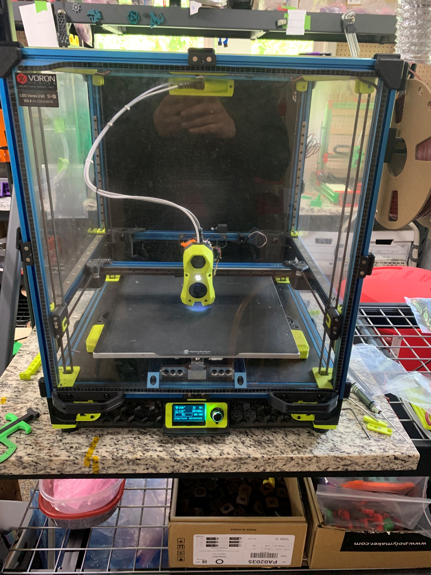
Voron V2.4 350 - 3812

Slide 3
Printer Mods
Stealth Burner
Mellow Fly SB-2040 toolhead board
Rapido v1
0.4 CHT
Umbilical – using igus cable (prefer 3do cable)
Rama Idlers
Pin Mod (xy joints and AB motor mounts)
Hartk umbilical pass through
Nevermore x2 on left and right side of build plate
Mandala Rose Works build plate with magnets
Mandala Rose Works Kinematic Kit
TI backers (x and y)
FlexTap (AndrewMcGr)

Slide 4
What is the difference
Klipper uses a default damping ratio of 0.1 in the calculation of the shapers.
Shaketune uses the damping ratio calculated from the measured graphs in the calculation of shapers.
Both use the built-in TEST_RESONANCE macro to run.
Thus, the major difference is how the shaper values are calculated

Slide 5
Belt Shaper
Shaketune
Click “Belt Shaper Calibration” in mainsail
Files in mainsail in config files
Klipper
https://www.klipper3d.org/Measuring_Resonances.html#testing-custom-axes
Commands (run individually in this order)
TEST_RESONANCES AXIS=1,1 OUTPUT=raw_data
TEST_RESONANCES AXIS=1,-1 OUTPUT=raw_data
~/klipper/scripts/graph_accelerometer.py -c /tmp/raw_data_axis*.csv -o /tmp/resonances.png (ssh)
Files in /tmp

Slide 6
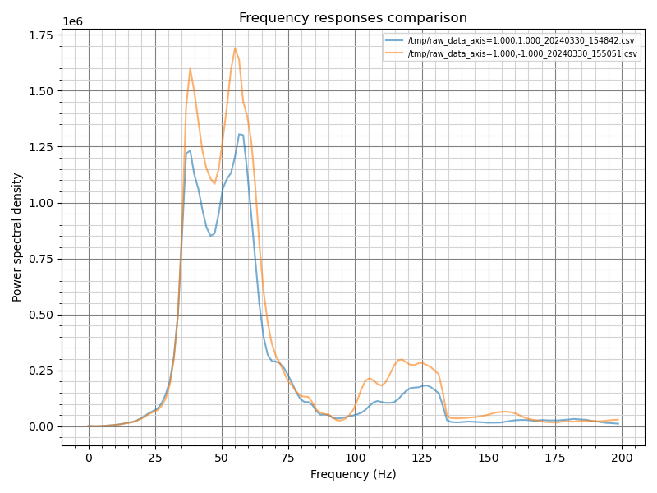
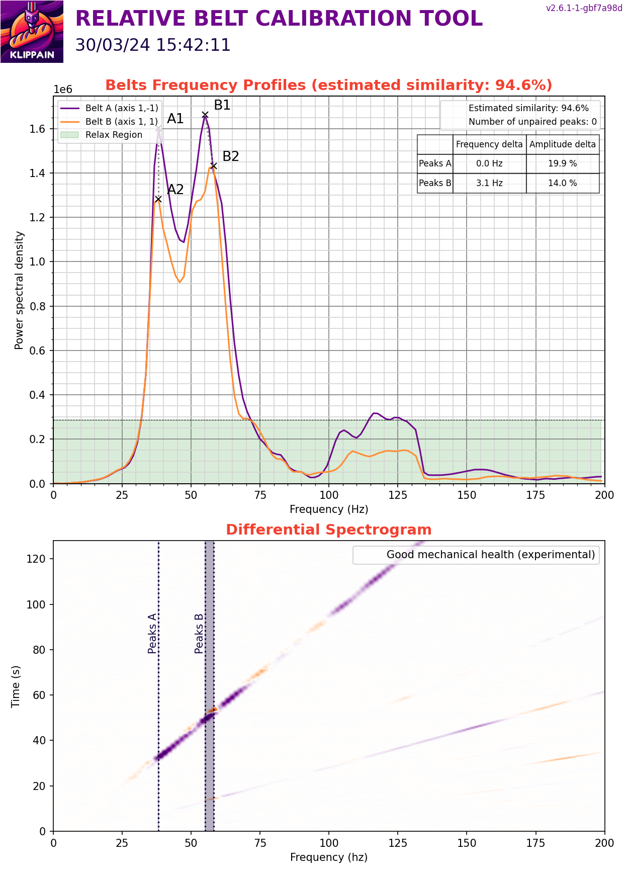
BeltShaper with FlexTap

Slide 7
Input Shaper
Shaketune
Click “Axes Shaper Calibration” in mainsail
Files in mainsail in config files
Klipper
https://www.klipper3d.org/Measuring_Resonances.html#testing-custom-axes
Commands (run individually in this order)
TEST_RESONANCES AXIS=X
~/klipper/scripts/calibrate_shaper.py /tmp/resonances_x_*.csv -o /tmp/shaper_calibrate_x.png (ssh)
TEST_RESONANCES AXIS=Y
~/klipper/scripts/calibrate_shaper.py /tmp/resonances_y_*.csv -o /tmp/shaper_calibrate_y.png (ssh)
Files in /tmp

Slide 8
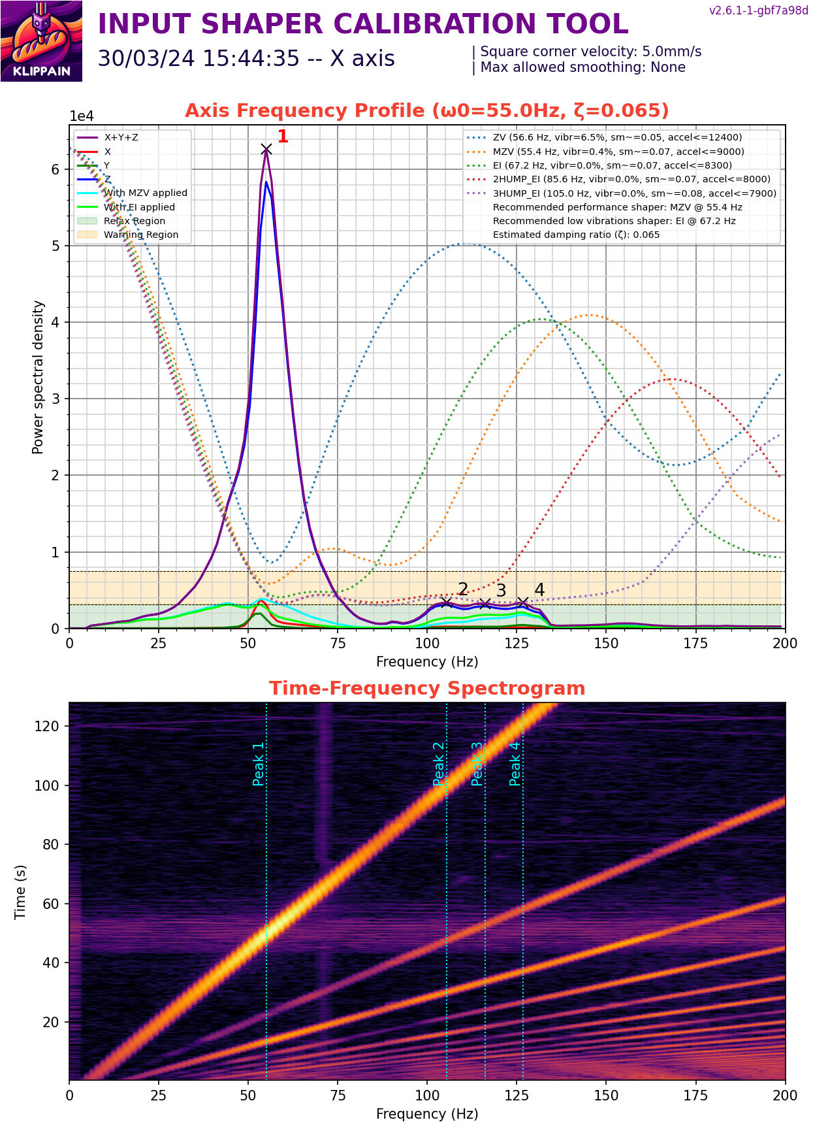
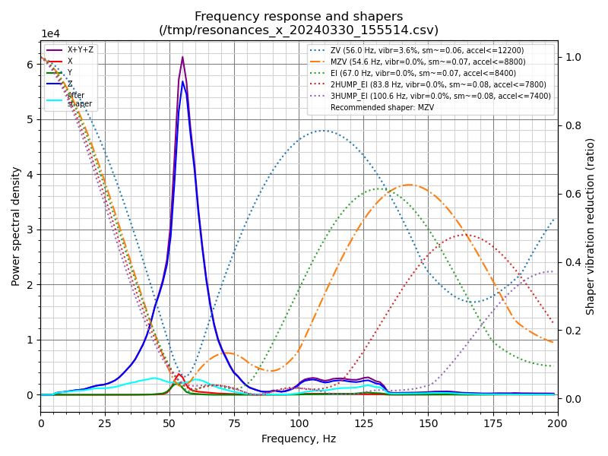
Input Shaper = x (FlexTap)

Slide 9
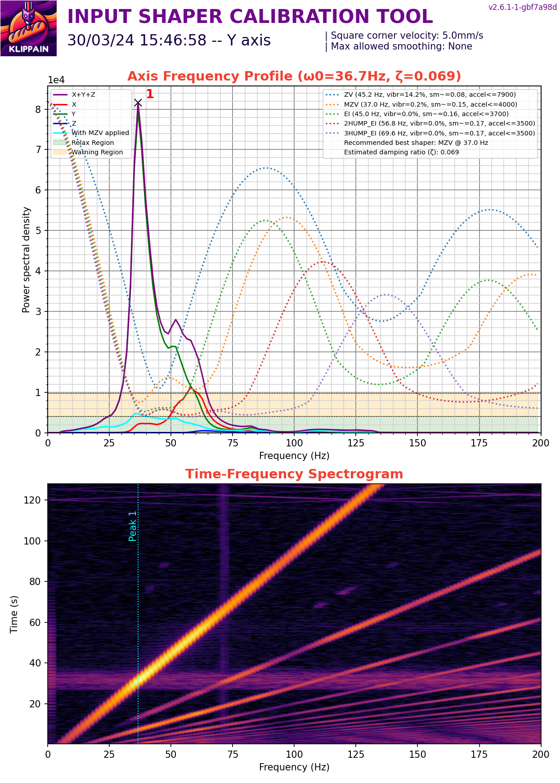
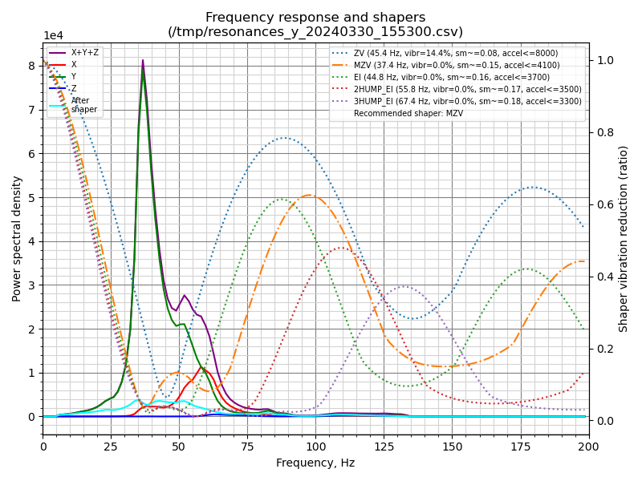
Input Shaper = y (FlexTap)

Slide 10
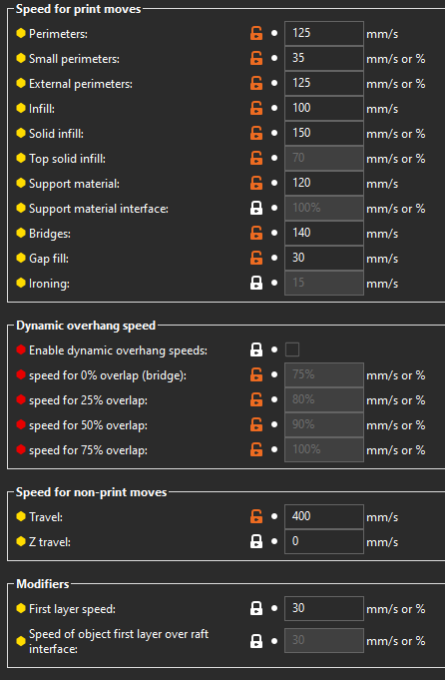
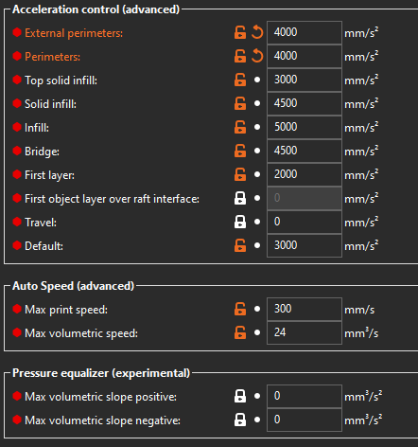

Prusa Slicer 2.7.2 setting note: ext/int perimeter accel changes between prints
SCV=5.0

Slide 11
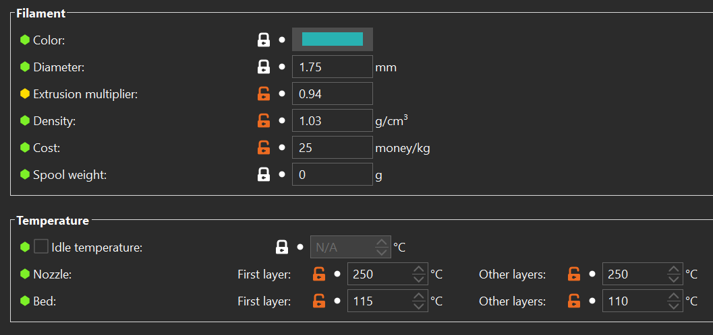
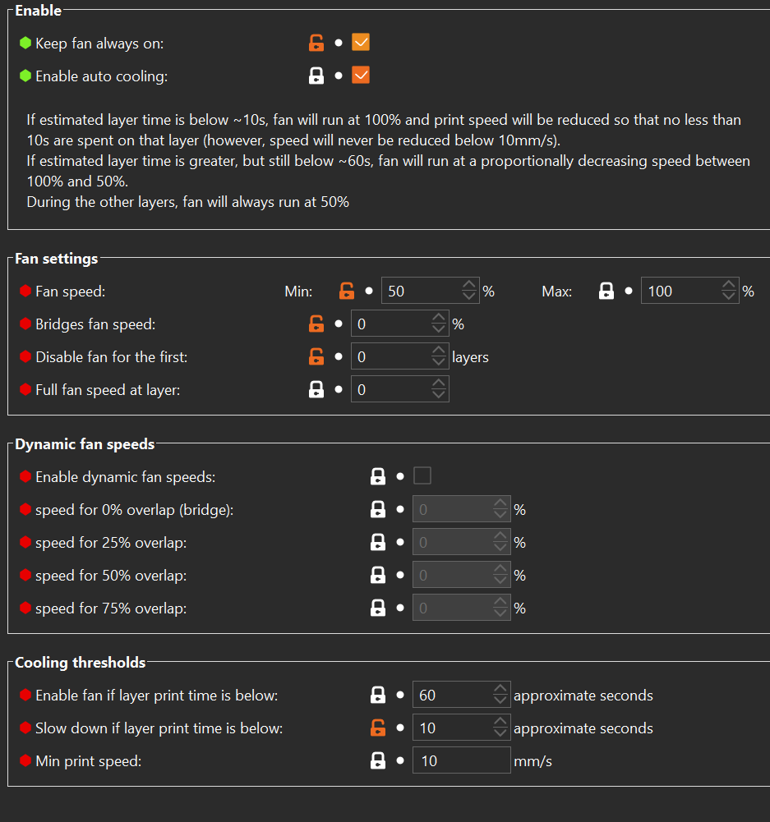
Filament Settings: KVP ABS

Slide 12
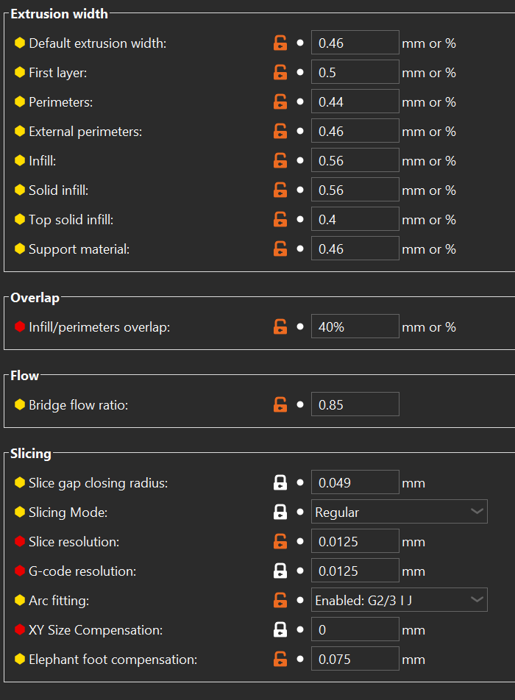
Line widths
Note:
Chamber preheated to 45 C (37 min)
Chamber temp over total prints 57.5 C
0.2 layer height
0.44/0.46 int/ext perimeter width

Slide 13
ADXL settings
#Shaketune MZV
[input_shaper] shaper_freq_x: 55.4 shaper_type_x: mzv damping_ratio_x: 0.065 shaper_freq_y: 37.0
shaper_type_y: mzv damping_ratio_y: 0.069
#Shaketune EI
[input_shaper]
shaper_freq_x: 67.2
shaper_type_x: ei damping_ratio_x: 0.065
shaper_freq_y: 45
shaper_type_y: ei
damping_ratio_y: 0.069
#Klipper MZV
[input_shaper] shaper_freq_x: 54.6
shaper_type_x: mzv shaper_freq_y: 37.4
shaper_type_y: mzv

Slide 14
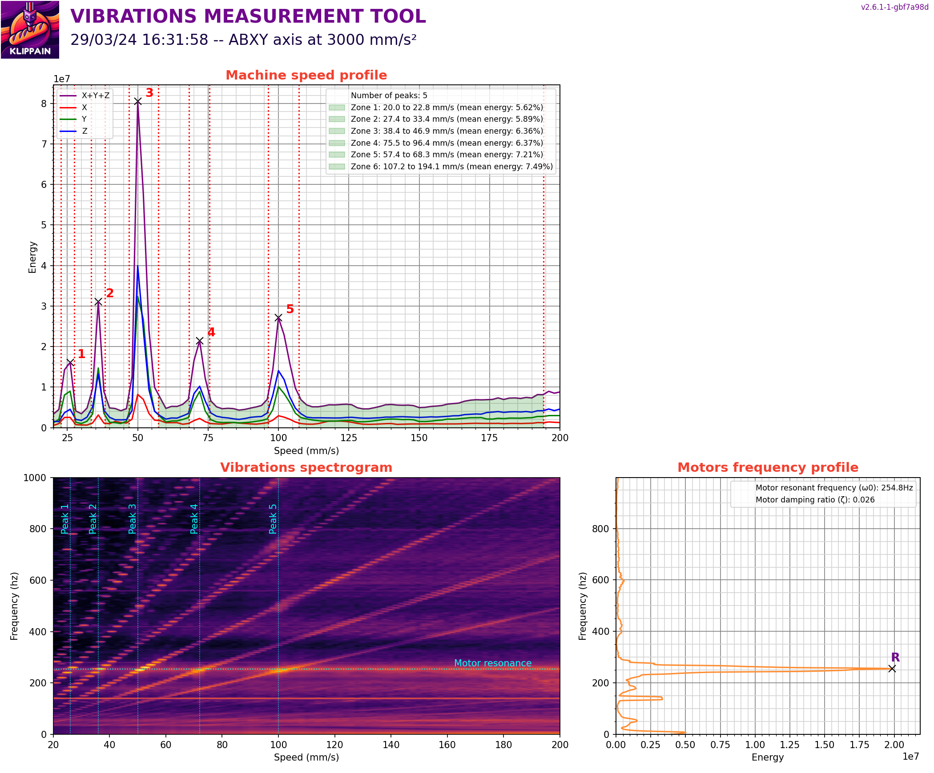

Slide 15
Let’s push it
1) Increased accel to 4k on shaketune MZV
2) internal/external perimeter speed=250
Internal perimeter accel = 6000
3) Increased Max volumetric speed/flow from 24 to 30
external perimeter speed = 350
Internal perimter speed =325
Solid infill = 275
Solid infill accel = 6000
4) Increased max volumetric speed/flow from 30 to 35
External perimeter speed = 375
Internal perimeter speed = 390
Infill = 155
Top solid infill = 125
Gap fill =125
internal perimeters accel = 6000
Top solid infill accel = 6000
Solid infill accel = 8000
Infill accel = 8000
5) increased max volumetric speed/flow from 35 to 40
External perimeter speed = 435
Internal perimeter speed =450
Infill = 190
Solid infill = 350
External Perimeter accel = 7k
Top solid infill = 7k
Solid infill = 9k
Infill = 9k
Travel = 10k
Small perimeter = 70

Slide 16
What I settled For…
6) Kept max volumetric speed/flow at 40
Speeds
Internal perimeters = 250/125
External perimeters = 250/125
Small perimeters = 85
Infill = 190
Solid infill = 125
Top solid infill = 125
Travel = 300
Max print speed = 400
Accels
External perimeter accel = 4000
Internal perimeter accel = 4000
Top solid infill = 4000
Solid infill = 4000
Infill = 6000
Travel = 8,000
Filament
EM 0.94 to 1.05 to 0.95

